Slide 1
LoJack: Tech for your customers. Profit for you. | << MONTH >> 2022
Notes:
Grab the dealer’s logo off their website. If they have digital retailing in place and an associated image. Insert image in right, left or both content areas. Click the ‘picture’ icon within the box to add. It will autosize

Slide 2
Spireon Technology
All core technology developed & owned by Spireon
In-house team of 120+ hardware, software and data engineers
Direct control of all features and roadmap priorities
Direct integration with top US cellular network providers including AT&T, Verizon, Sprint and T-Mobile
Hardware with 10+ year horizon for network compatibility
Comprehensive API for optional integration into dealer operations including direct relationship with Reynolds, CDK, DealerTrack, AutoMate, PBS, Darwin, F&I Express and HomeNet

Slide 3
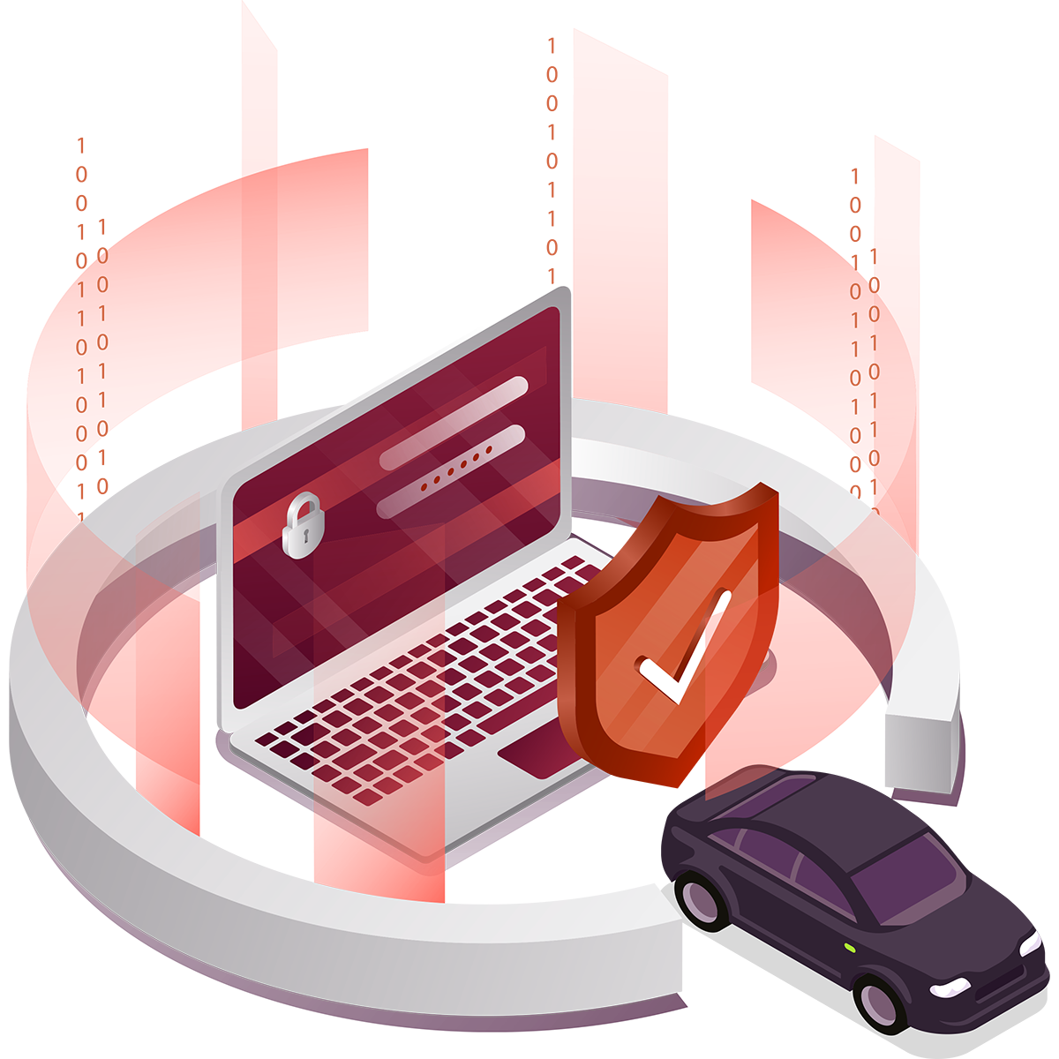
Our Commitment to Security at Spireon
15+ year track record as a GPS pioneer serving dealers with over 16 million vehicles
Best-in-Class Security Technology
Data protection through encryption of stored data as well as transport data through TLS (Transport Layer Security).
Secure and Protected Devices
All devices are hidden covertly in the interior of the vehicle with tamper protection.
No PII (Personal Identifiable Information) can be obtained from the device.
Abiding by Security Standards
Leverage standards and industry best practices set by:
NIST (National Institute of Standards & Technology)
CIS (Center for Internet Security) Critical Security Controls
© 2021 Spireon, Inc. All Rights Reserved.
Notes:
Battery Management
Reports every 6 hours when vehicle is not driven
When not reporting, goes into ‘hibernate’ mode, drawing less than 0.1 milliamps.
Redundancy
When out of range/no coverage, device stores events and reports them when data connection is restored

Slide 4
Award-Winning Service and Products
Net Promoter Score of 77 (2020)
Numerous Customer Service Awards
White Glove Service

Slide 5
What Does LoJack Do for Dealers?
Make Money. Save Money. Retain Customers.
Manage & Protect Inventory
Drive Service Retention
Improve PVR
Notes:
Benefits that move beyond F&I

Slide 6
LoJack Product Overview & Dealer Benefits

Slide 7
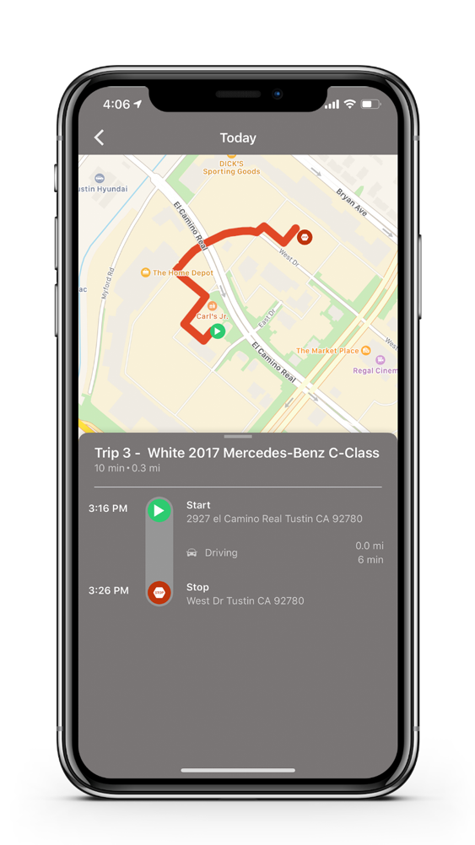
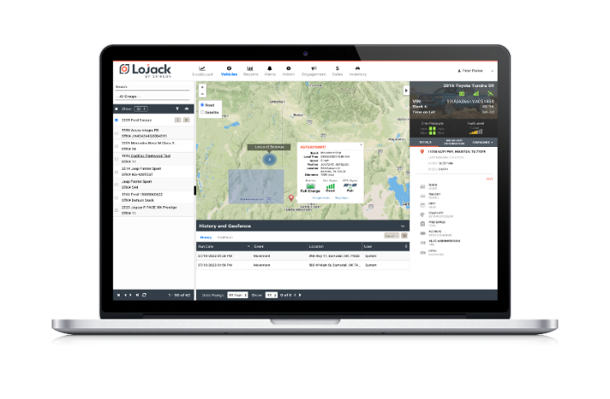
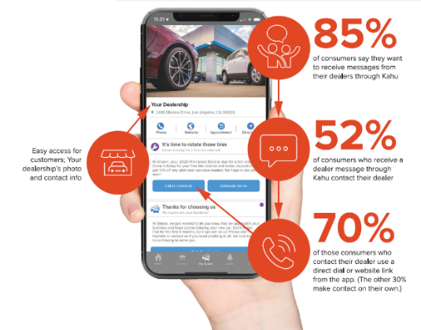
Product Overview & Dealer Benefits
F&I Profit
Lot Management &
Stolen Vehicle Recovery
Consumer Engagement & Retention
60%+
<30 Minutes
8-12x
Average Penetration Rate
Reduce Purchase Time
by Up to 30 Mins
Consumer App Usage Per Month
$300 - $500
98% | $10K
4.8 Stars
Profit Per Vehicle
Stolen Vehicle Recovery Rate /
Theft Guarantee (up to $10K)
Consumer App Rating
9x
Up to 300%
52%
Dealership ROI
Streamlined Inventory Audits
Campaign Conversion Rate
Notes:
Benefits that move beyond F&I

Slide 8
Make Money. Save Money. Retain Customers.
An Integrated Value Proposition
That Addresses Critical Pain Points
Front-end margin compression
Lack of technology enabled sales process
Lack of vehicle theft protection for dealers
Lack of apps focused on dealer v OEM brand
Lack of direct one-to-one consumer marketing for the duration of vehicle ownership
Volatile dealer service retention and drop in full life-cycle management
Low absorption
Make $ - Improve PVR
Save $ - Manage & Protect Inventory
Retain Customers - Drive Service Retention
© 2022 Spireon, Inc. All Rights Reserved.
Notes:
Benefits that move beyond F&I

Slide 9
What Does LoJack Do for Dealers?
Make Money. Save Money. Retain Customers.
Manage & Protect Inventory
Drive Service Retention
Improve PVR
Notes:
Benefits that move beyond F&I

Slide 10
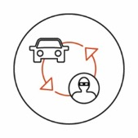
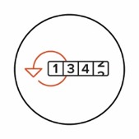
F&I Profit: Connected Car Vehicle Management for Consumers
Virtual Glove Box
See your history of service records and maintenance schedules in the LoJack app
Stolen Vehicle Recovery
98% recovery rate; average recovery time of 26 minutes
8 to 12 Sessions per month
Avg LoJack Consumer Usage
Vehicle Location
Know where your vehicle is, at all times, from your phone
Trip History
See a map of where your vehicle has been by date, time, trip length and more
Driving Behavior Alerts
Know how your vehicle is being driven with alerts for speed & geo-boundaries
Service & Recall Notices
Keep your car healthy with service reminders, recall notices and click-to-schedule appointments
Financial Guarantee
Receive up to $10,000 reimbursement if vehicle is not recovered in 30 days
COMMUNICATE THROUGH A TRUSTED APP
Privacy Guarantee
Your data stays private. You control who sees location, history, alerts and more.
CONSUMER
4.8
>27K Ratings
APP RATING
Low Battery Alerts
Receive low-battery alerts to avoid getting stranded
© 2022 Spireon, Inc. All Rights Reserved.

Slide 11
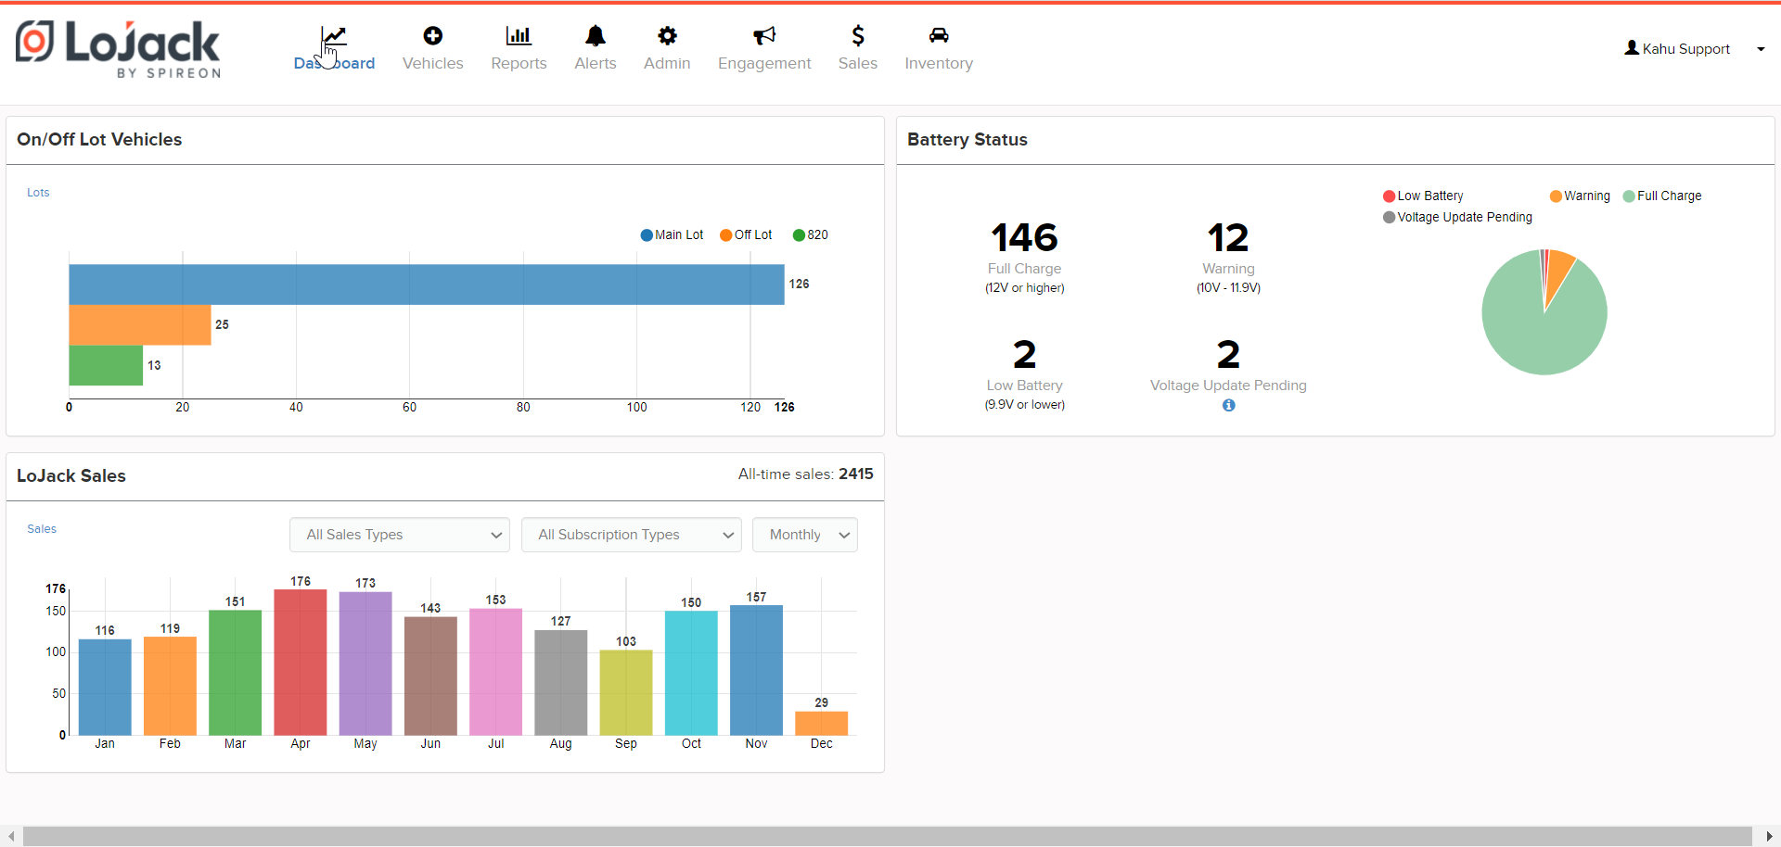
F&I Profit: Revenue Example
Actual Dealer
LoJack 5-Year Subscription
Cost: $359
MSRP: $895
Net Profit: $536
Annual ROI: $700,016
ROI Potential*
LoJack 3-Year Subscription
Cost: $300
MSRP: $895
Net After Cost: $595
Annual ROI: $963,900
* Based on national average LJ dealer run rate

Slide 12
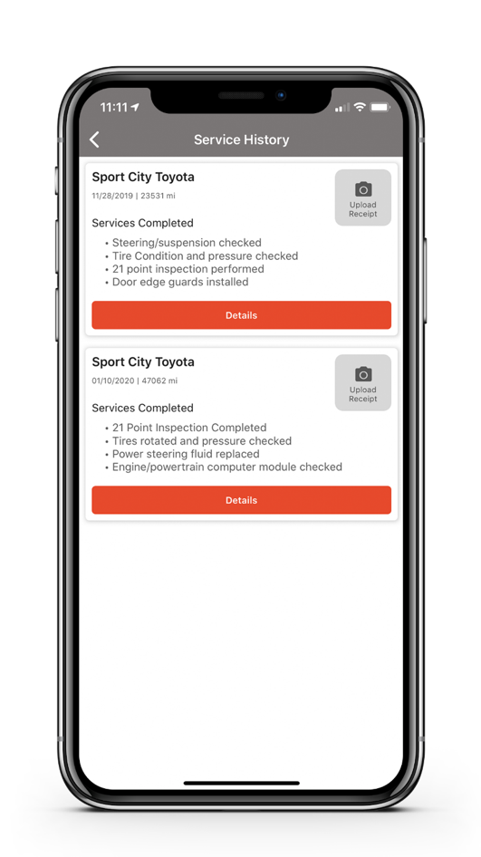
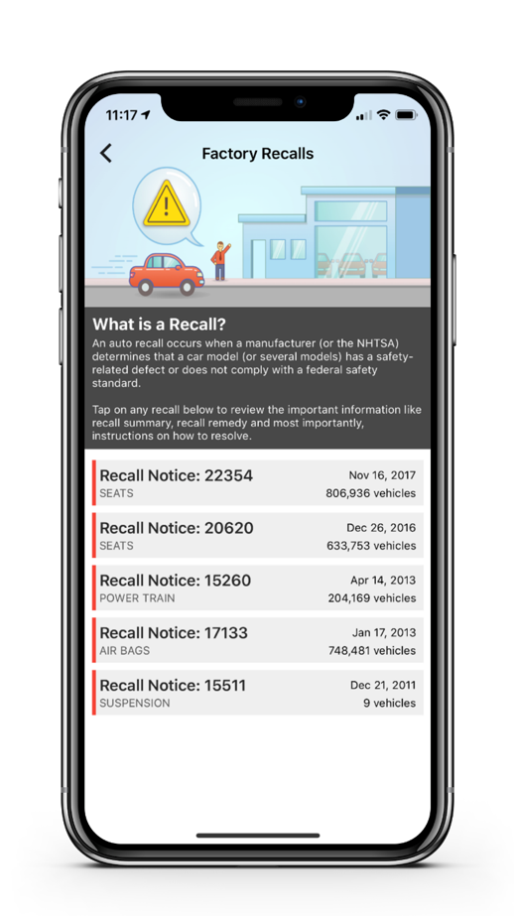
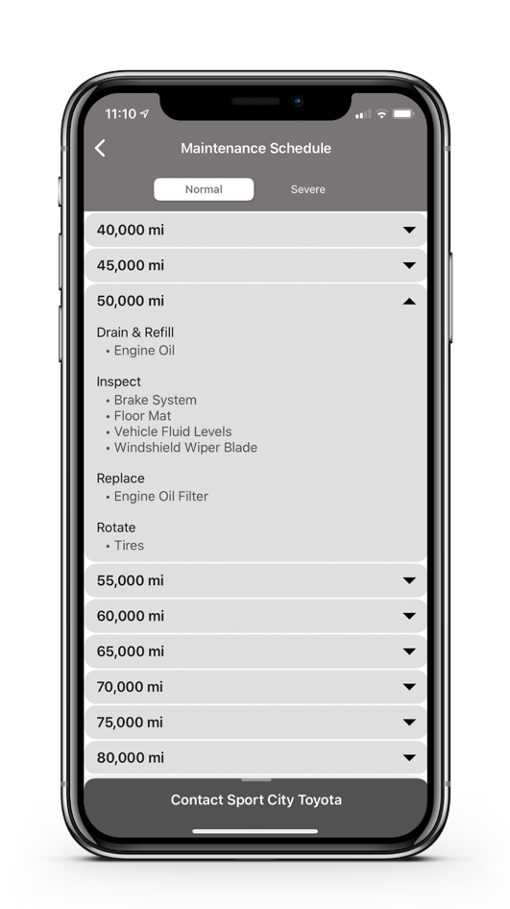
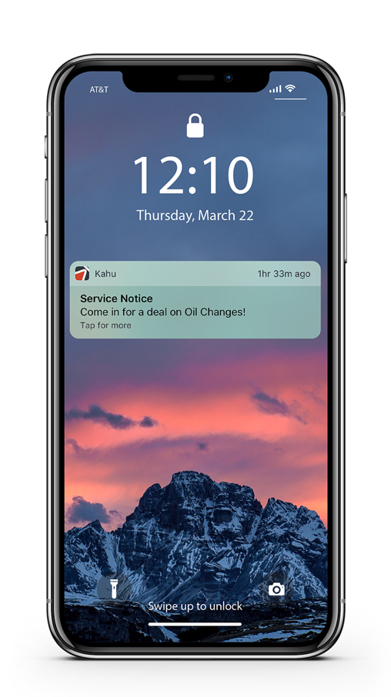
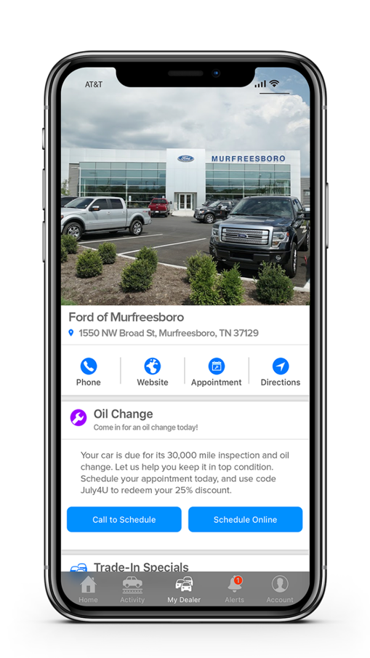
Service Profit: MyDealer - Automated Retention Campaigns
Real-time vehicle mileage (from LoJack)
Service history & last mileage
(from DMS)
Vehicle-specific service schedule
(from OEM)
Consumer In-App Service Retention Drivers
OEM Recommended Maintenance Schedules
(VIN-specific)
Dealership Service History
Recall Notices
(VIN-specific)
LoJack Automated Campaign Engine
Calculates mileage for next visit
Sends notification when vehicle reaches target mileage
Tracks response rates & follow-up ROs generated
Places dealership’s contact info & messages in palm of customer’s hand

Slide 13
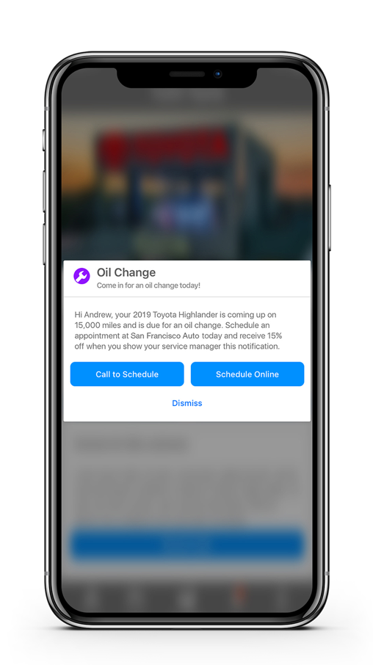
Service Profit: MyDealer - Service Retention
Put your dealership’s contact information and messages in the palm of your customers’ hands
Deliver your service messages through a trusted app:
Used ~12x per month
With 4.8 star rating from >27K users
Use automated campaigns or create your own
Notes:
Refer a friend
Seasonal specials and promos
Trade in event

Slide 14
What Does LoJack Do for Dealers?
Make Money. Save Money. Retain Customers.
Manage & Protect Inventory
Drive Service Retention
Improve PVR
Notes:
Benefits that move beyond F&I

Slide 15
Lot Management Overview
The goal in dealerships is to keep customer satisfaction up, but also to speed up the sale process. LoJack is a huge tool we use for that.”
– General Manager, Large Volume Import Franchise
On-demand vehicle location & intelligence
Technology enabled
sales process
Stolen vehicle recovery
Digital audit tool
Notes:
PERSONALIZATION: If dealer uses digital retailing with an associated image - Insert image in right, left or both content areas.
<< Click the ‘picture’ icon within the box to add; image will auto size. >>
On-demand
Feature based search
On Lot
Off lot
Aged units
Vehicle health
Tech enabled
Compliments Digital Retailing
Reduce time to purchase by 30+ minutes
Drives CSI
Test drive
Benchmarking
Sales person conversion measurement
Safety/security
SVR
90%+ recovery
Avg 26 mins
$10k theft benefit
Audit
Reduces human capital reliance & cost

Slide 16
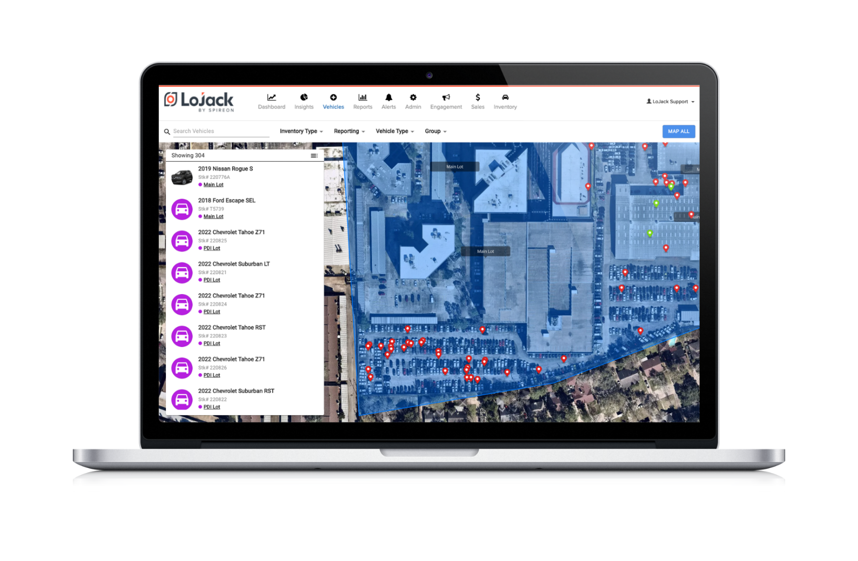
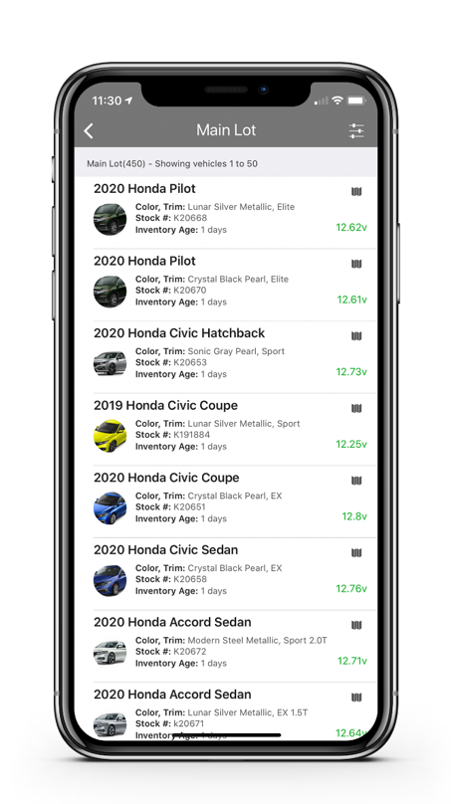
Lot Management: Technology Enabled Sales Experience
Reduce purchase time by 30 minutes: find cars in seconds by vehicle age, stock, VIN, make / model
Streamline inventory audits up to 300%
Reduce average battery management time by >50%
Instant battery status & walking directions
Manage protected & unprotected assets by lot, car count, on/off lot and battery health
Increase trade ups by monitoring loaner mileage
© 2022 Spireon, Inc. All Rights Reserved.

Slide 17
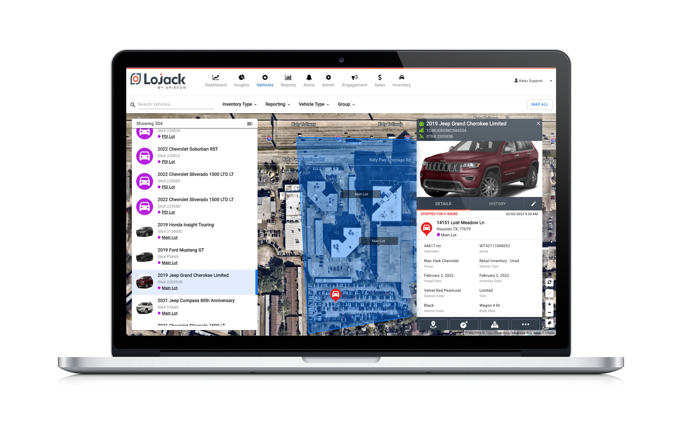
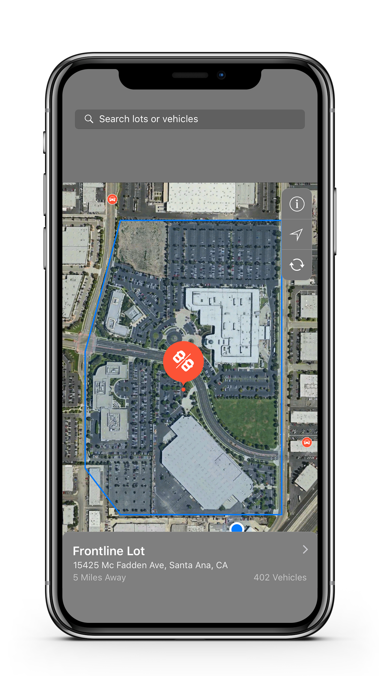
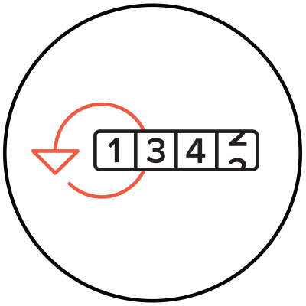
In-Depth Views
Examples
Pinpoint vehicle location & drive history
View inventory by lot down to individual vehicle
View loaner location & mileage
Set service mileage thresholds - pull vehicle reports for marketing
View test drives by vehicle & route

Slide 18
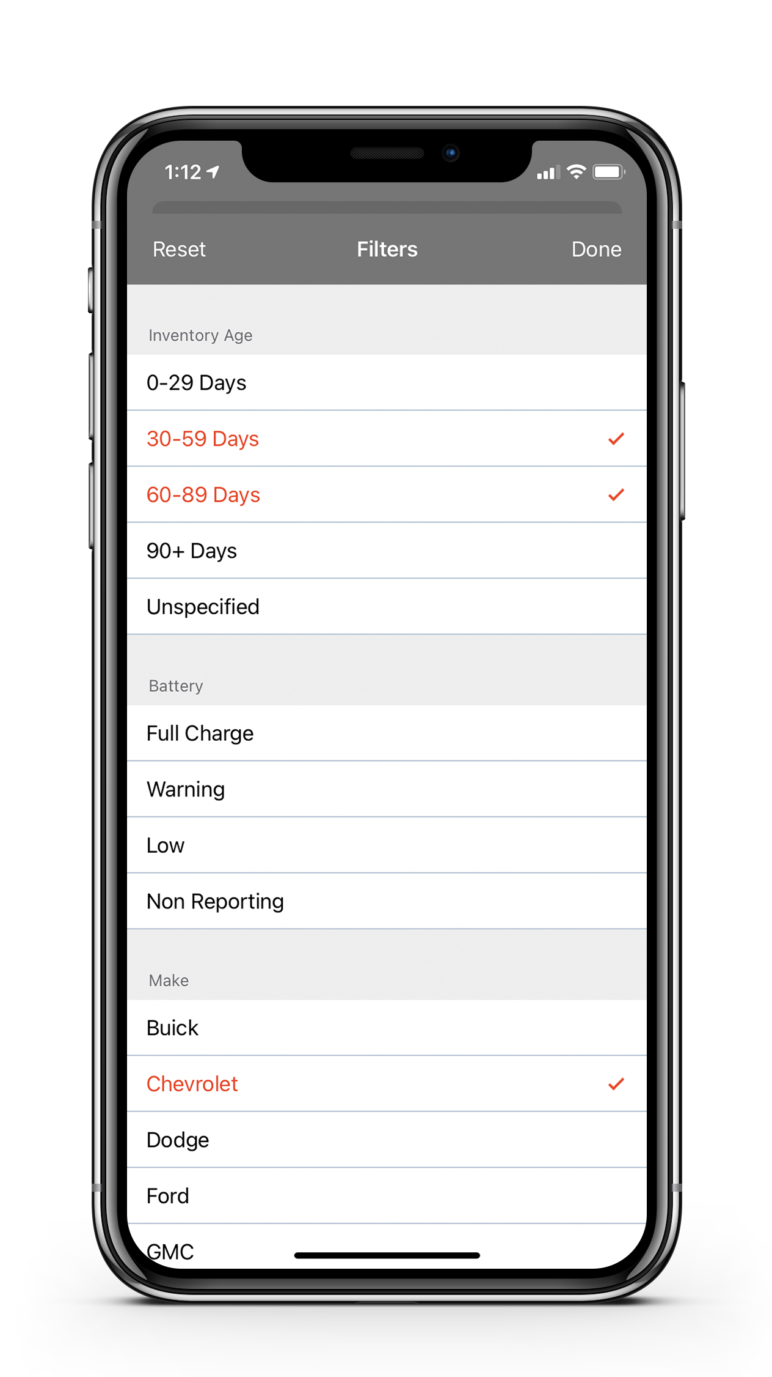
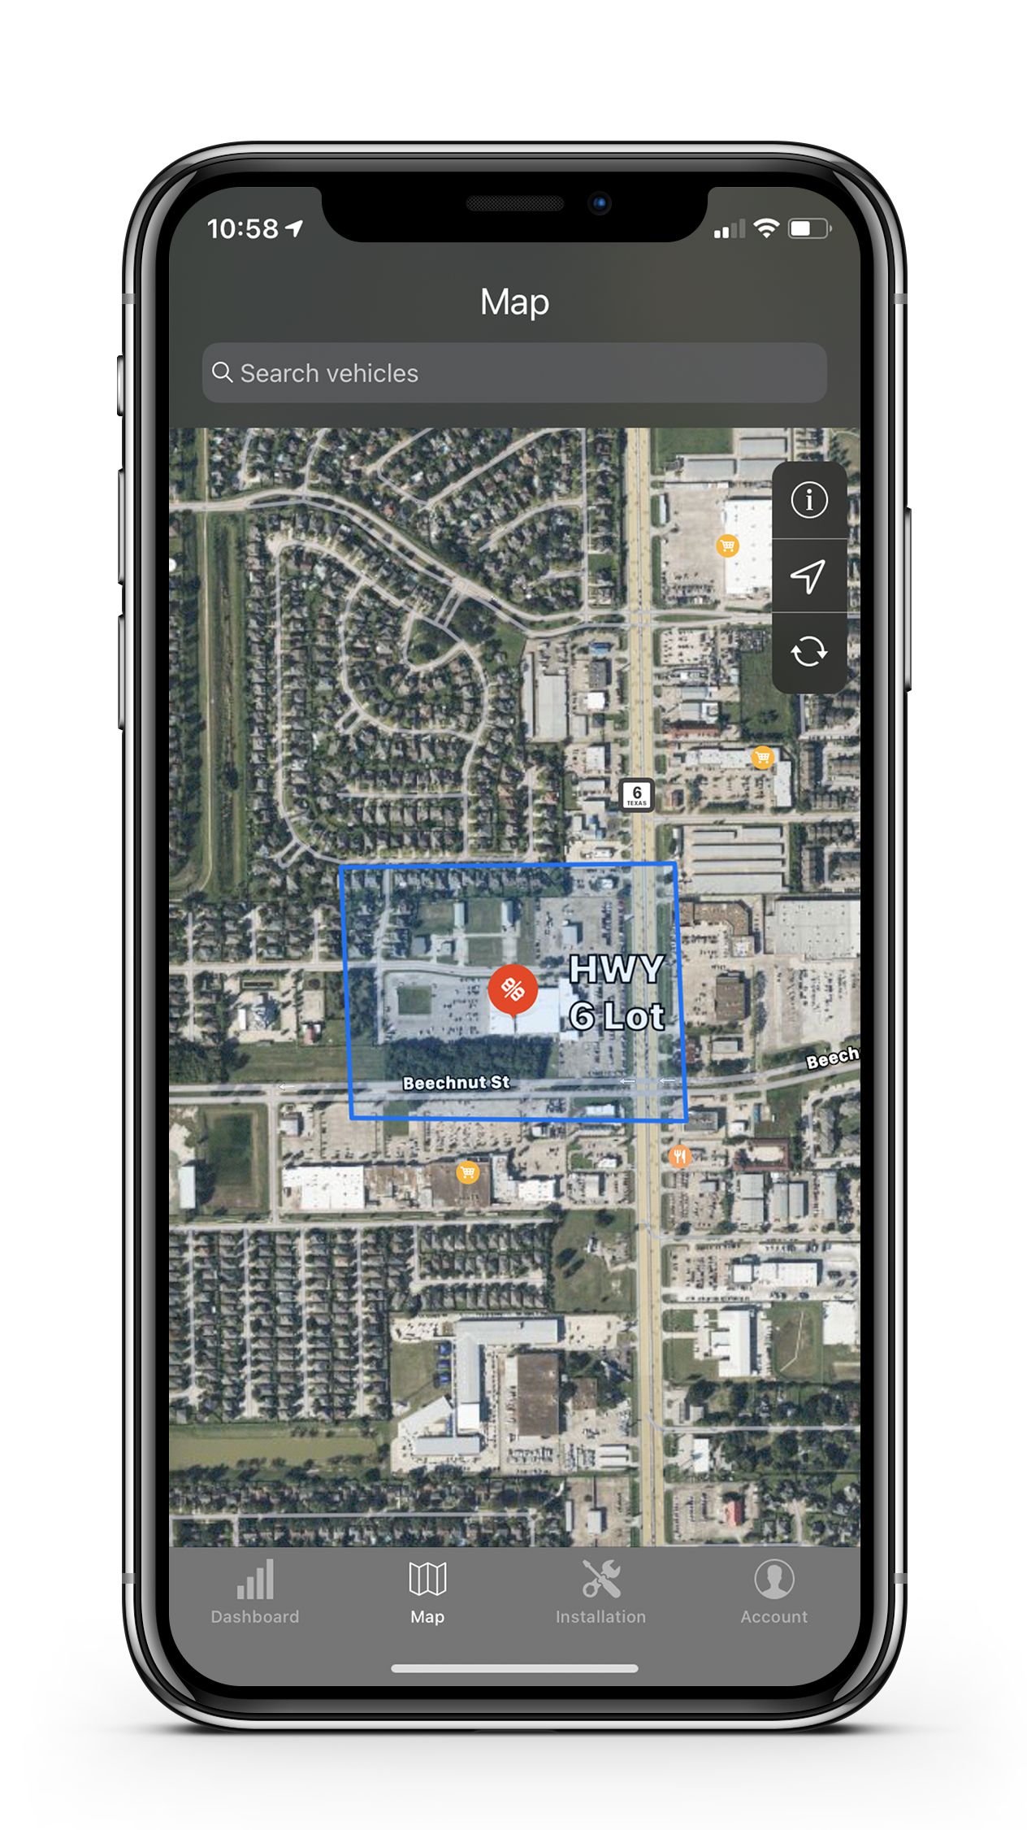
Actionable Sales Features - Vehicle Search Attributes
Manage vehicles by aging, OEM, color or trim level
Target specific vehicles such as aged units to improve turn
Pin-point vehicle efficiently to guide sales with consumer

Slide 19
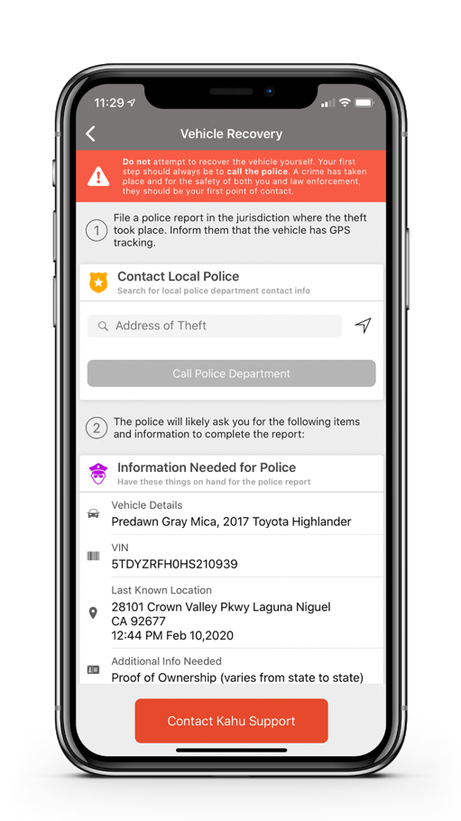
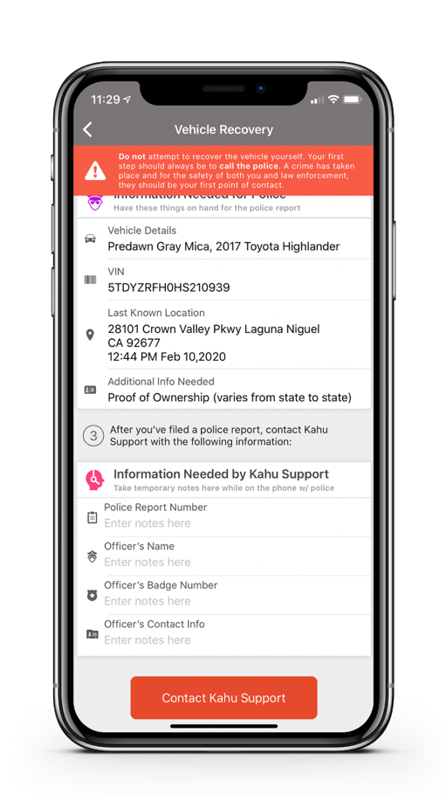
Industry’s Best Stolen Vehicle Recovery
INDUSTRY’S
FASTEST
BEST SVR
AVERAGE RECOVERY TIME
PSAP integration – Expedites stolen vehicle in law enforcement queue as 'Crime in Progress'
Critical vehicle information provided, so dealers / consumers are ready to file a police report
Save police report information to provide to Customer Support
Concierge service
Receive alerts when cars leave lots after hours
Up to $10K per vehicle coverage (dealer & consumer)
Information Needed by LoJack Support
Contact LoJack Support
Contact LoJack Support
Notes:
No changes to SkyLink mobile app.

Slide 20
What Does LoJack Do for Dealers?
Make Money. Save Money. Retain Customers.
Manage & Protect Inventory
Drive Service Retention
Improve PVR
Notes:
Benefits that move beyond F&I

Slide 21
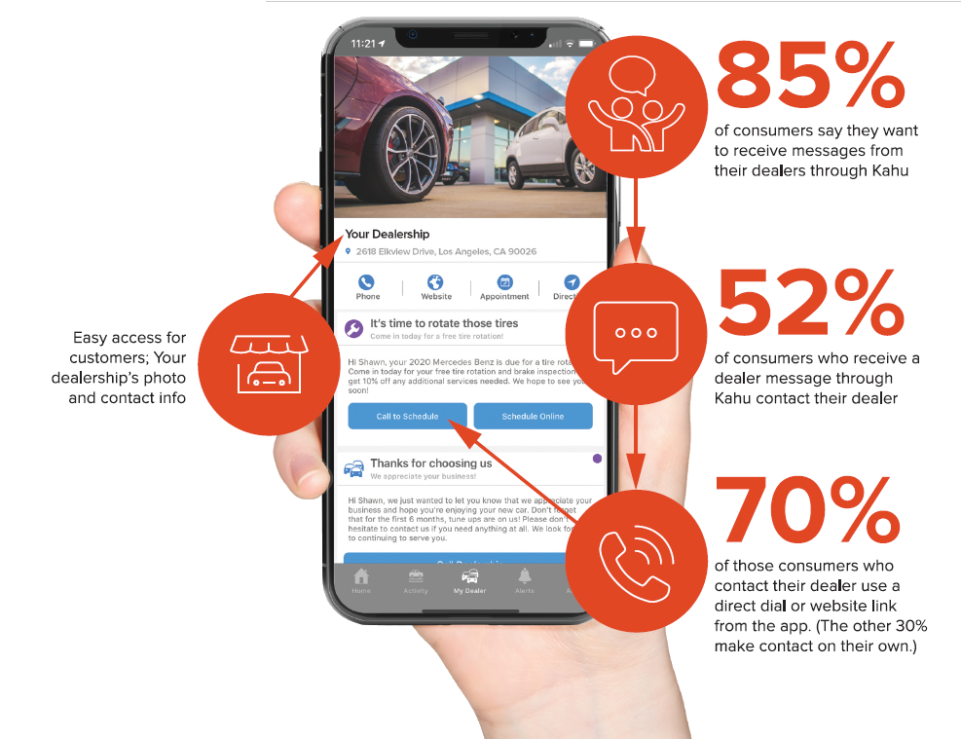
MyDealer Campaigns Deliver a 52% Dealer Contact Rate
of consumers say they want to receive messages from their dealers through LoJack app
Boost Fixed Ops Revenue
Build Customer Loyalty
Deliver Results through:
Service Reminders
Promotions
Recalls etc.
Easy access for customer; your dealership’s photo & contact info
of consumers who receive a dealer message through LoJack app contact their dealer
of those consumers who contact their dealer use a direct dial or website link from the app. (The other 30% make contact on their own.)
© 2021 Spireon, Inc. All Rights Reserved.
Notes:
PERSONALIZATION: If Dealer has a rewards program and an associated image…
<< Insert image in content area; click ‘picture’ icon within the box to add. Image will auto-size. >>

Slide 22
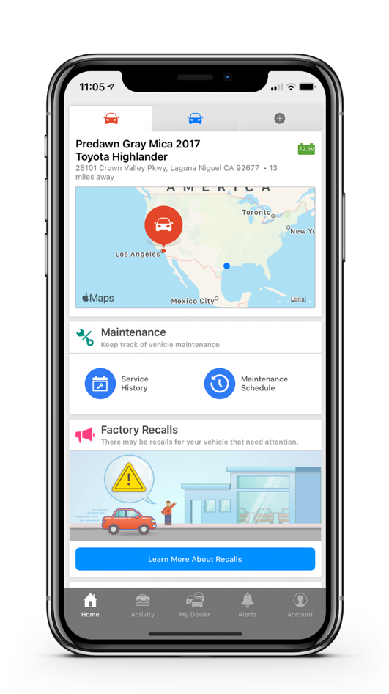
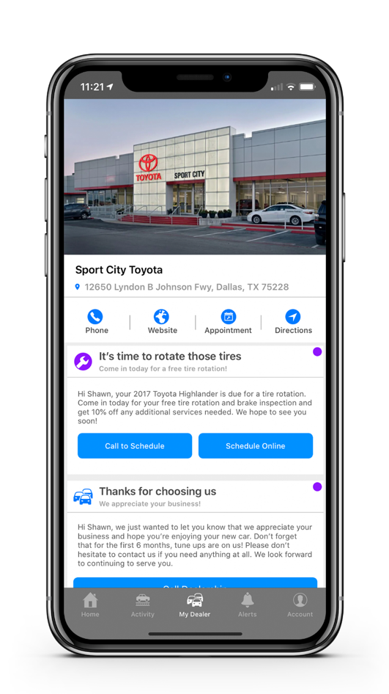
Service History and Maintenance Schedules w/ MyDealer 2.0
Maintenance and Service on dashboard
History of service at the dealership
VIN-specific recommended maintenance schedules
Service alerts automatically pushed based on last service mileage, recommended service schedule, and miles driven.

Slide 23
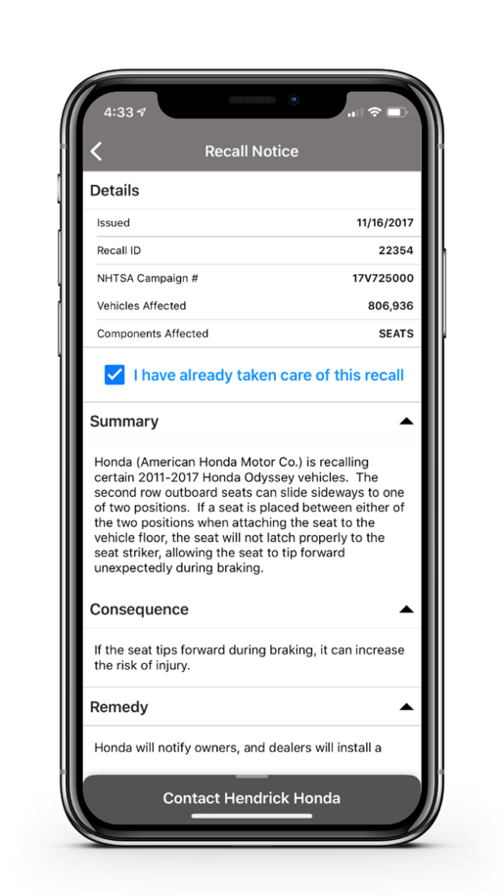
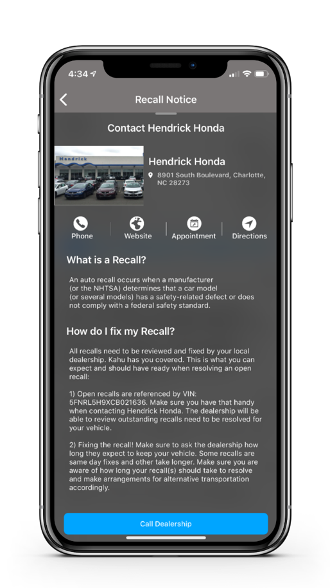
Recall Notices – Drive Additional Revenue
VIN applicable - automatically populate consumer app
Actionable - directly connect to call or book appointment via the app
No additional marketing costs and effort
On average, LoJack consumers have been measured to use the app 12x per month

Slide 24
Hardware & Device Installation

Slide 25
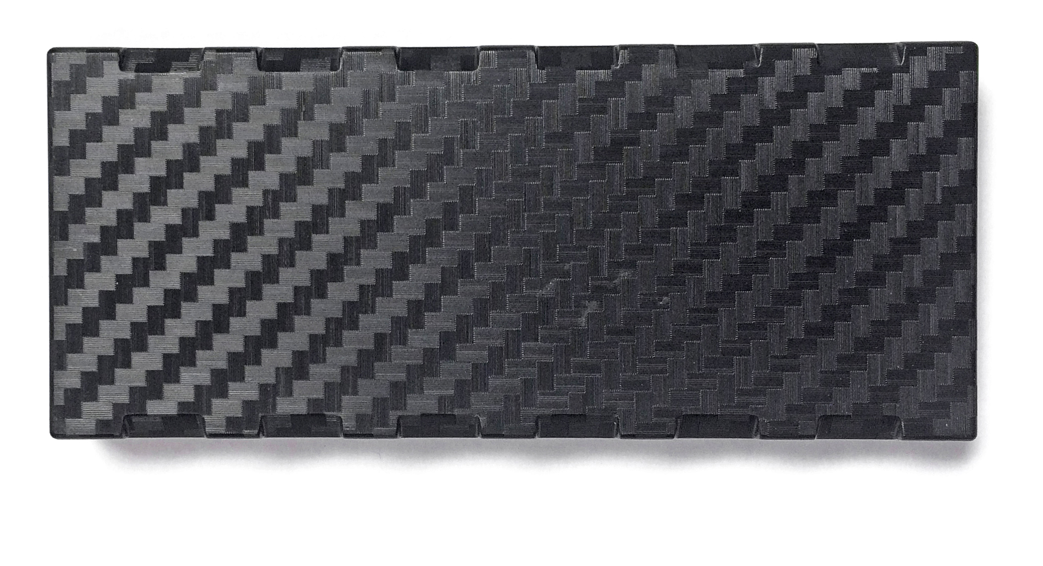
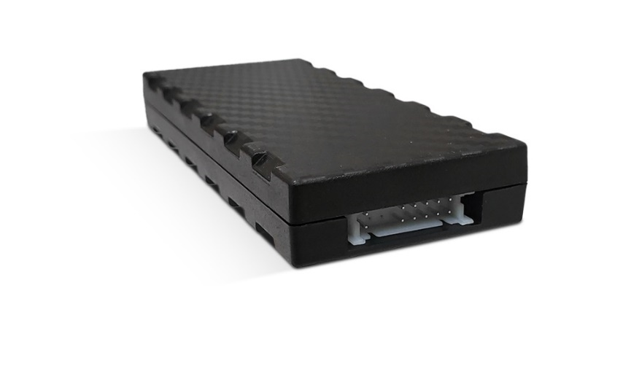
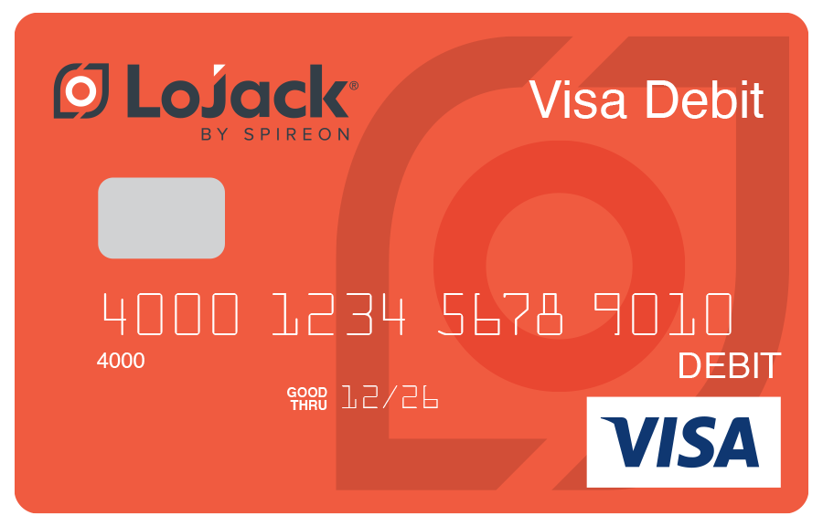
Hardware
Optimized for dealer management
Ultra low power management
Virtually undetectable micro-amp draw
Accelerometer controlled – increased accuracy
Unmatched communications reliability
Stores up to 20k events
Built on high frequency telemetry platform
Redundancy for store and forward message delivery
State of the art antenna design (>50% coverage over competition)
Dual-sourced hardware – reduced supply chain risk
Size compared to a credit card
© 2021 Spireon, Inc. All Rights Reserved.

Slide 26
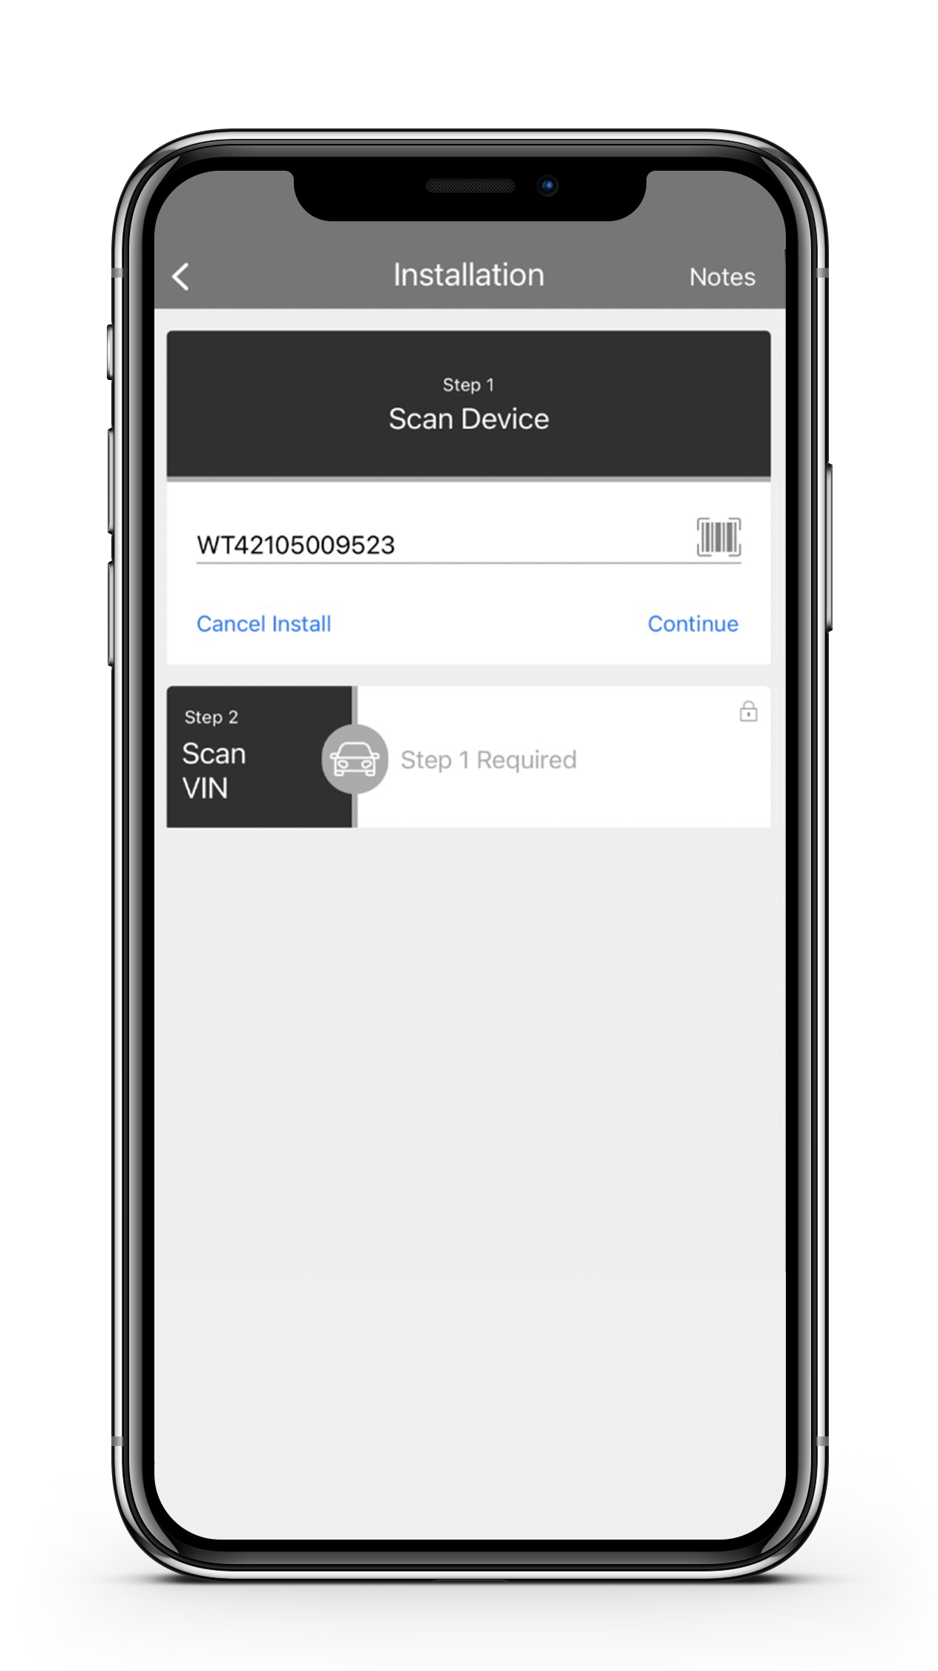
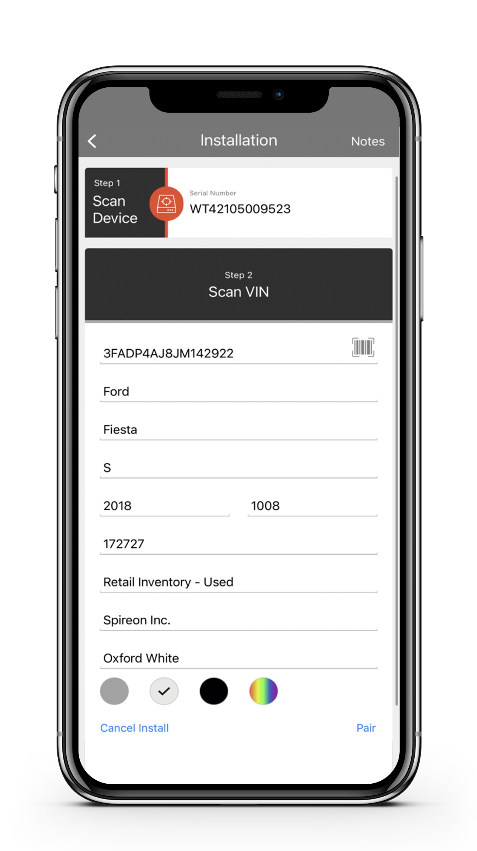
Simple Device Installation
Easy 2-step pairing, testing and validation
OBDII Harness or
Hardwire Installation
10–15 minute installation for trained technician
Connects to Power & Ground wires
Spireon installs launch inventory & trains store technicians
© 2021 Spireon, Inc. All Rights Reserved.

Slide 27
Client Success Best in Class Support

Slide 28
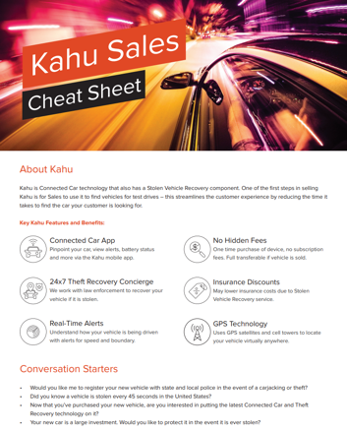
Successful Launch Execution – Enabling Your Team
Sales
F&I Manager
Parts Manager
How managers close a sale
Common manual updates
How to sell LoJack
Demonstrating the consumer app
Key buyer profiles
Conversation starters
Overcoming objections
Demonstrating the consumer app
Closing a LoJack sale
View device inventory
Order product
Operational best practices
LoJack Sales
Installation Manager
Connect using reliable hardwire connections (poke & wrap methodology)
Identify reliable non-switching 12-volt sources
Place & mount for optimal device performance
Leverage LoJack mobile app (vehicle pairing & installation validation)
Verify device is reporting information properly
Place LoJack marketing sticker
About LoJack
LoJack is Connected Car technology that also has a Stolen Vehicle Recovery component. One of the first steps in selling LoJack is for Sales to use it to find vehicles for test drive – this streamlines the customer experience by reducing the time it takes to find the car your customer is looking for.
Key LoJack Features and Benefits
© 2022 Spireon, Inc. All Rights Reserved.

Slide 29
In-Store Launch Team
Goal: Set Up a Dealer for Success
Highly experienced team executing honed best practices
Dealer Training Manager
Installation Lead
Configures LoJack web portal
Setup user accounts, loaner groups, alerts, lots & reports so your dealership can get the most out of LoJack
Trains your personnel on LoJack apps (both dealer & consumer), web portal, sales best practices and ordering devices to drive engagement
Ensures dealership has LoJack marketing materials to drive sales
Manages onsite Spireon Certified Installers
Manages install quality control
Ensures initial vehicle installations are done correctly and devices function properly
Conducts Technician Certification Training (classroom and hands-on), if applicable
© 2022 Spireon, Inc. All Rights Reserved.
Notes:
Put full bullets in notes – abbreviate words on screen

Slide 30
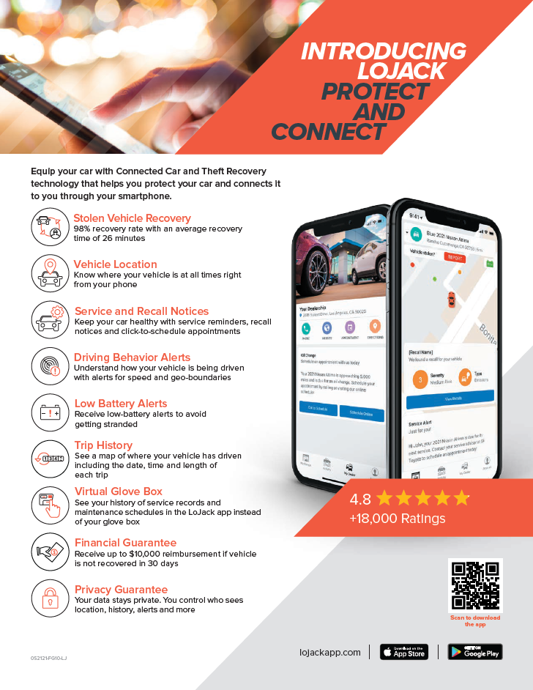
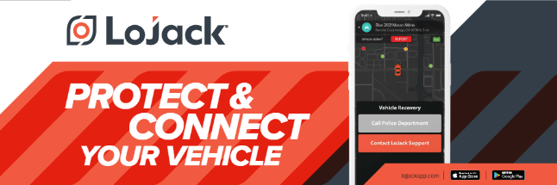
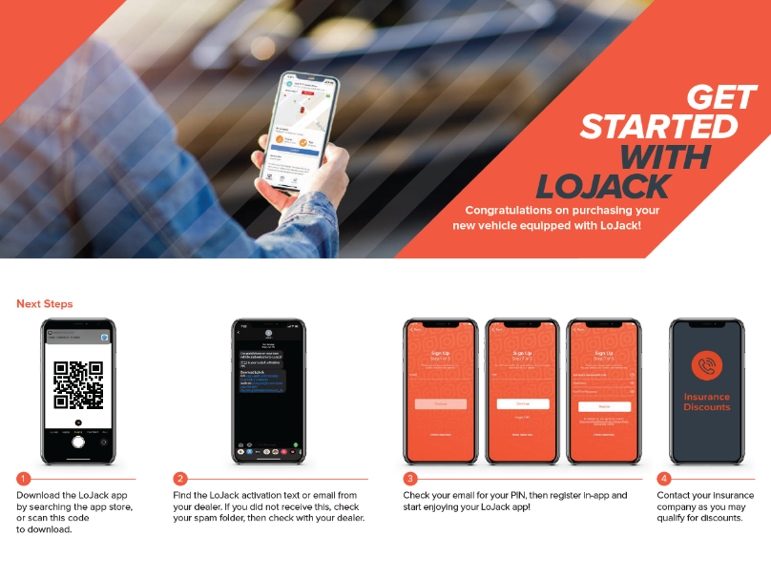
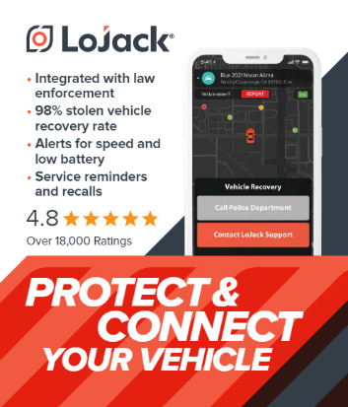
Training & Support for Upsell: Collateral and Signage
No cost to dealers
LoJack consumer video
Consumer brochures
Sell-through laminates
New-buyer brochures
Vehicle stickers
Table tents
Retractable banners
Car toppers

Slide 31
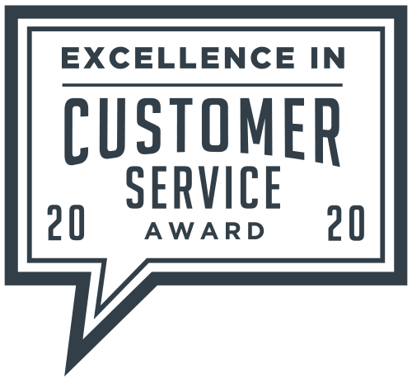
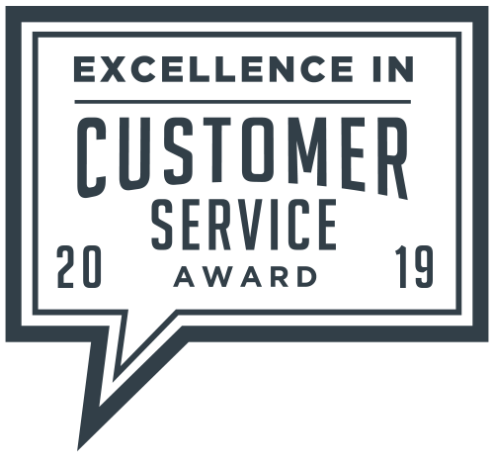
Award-Winning Customer Support
83%
of calls answered within 60 seconds
Average Speed to Answer
Net Promoter Score
1 min
21 sec
Customer Support (dealer & consumer)
M-F 5a – 6p PST through live support, app or email
Sat 8a – 5p PST
Navigation & education
Device troubleshooting
Process replacement requests (RMA)
77
Support Levels
Tier 1 – Frontline calls / requests
Tier 2 – Escalations (typically resolved in 48 business hrs.)
Tier 3 – Product Management / Engineering (priority, scope, timeline)
After-Hours Support
24 x 7 / 365 through live support, app or email
Stolen Vehicle Recovery
Sell-through failure
Installation failure
Account activation failure
© 2022 Spireon, Inc. All Rights Reserved.

Slide 32
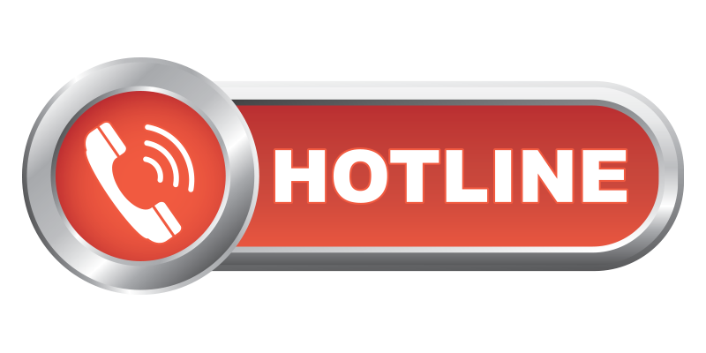
Award-Winning Customer Support
Dedicated Hotline - Stolen Vehicle Recovery
Direct partnership with law enforcement providing vehicle location
Ardent consumer support and vehicle recovery
Concierge service for dealers’ stolen inventory (includes proactive conferencing with law enforcement to file the report)
Law Enforcement Liaisons
Manages escalation process
Leverages existing network of contacts
Training broader SVR team for proper usage of law enforcement verbiage
Helps position theft as having ‘intent’ versus a civil matter, requiring extended litigation
© 2022 Spireon, Inc. All Rights Reserved.

Slide 33
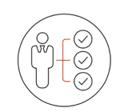
Ongoing Support & Account Management
ACCOUNT OWNER
Dealer Relationship Manager (DRM)
Virtual Performance Manager (VPM)
Acts as primary point for ongoing account management
Provides strategic support and industry best practices
Drives sell-through in Sales and F&I
Heightens client retention focus in Service through the MyDealer app
Monitors protected & unprotected inventory units to reduce risk
Provides refresher training
Helps manage device inventory for reordering purpose
Proactively identifies issues and makes recommendations to resolve issues
Manages day-to-day oversight of technology / usage
Provides virtual training & check-ins
Interacts weekly with dealer (coordinates with DRM)
Leads weekly calls with DRM / DSM to discuss account(s) and any risks / opportunities
© 2021 Spireon, Inc. All Rights Reserved.

Slide 34
Recap / Next Steps
Technology & Security
Solve Critical Pain Points
Make $ - improve PVR
Save $ - manage & protect inventory
Retain & engage service customers
Stolen Vehicle Recovery / Theft Guarantee
State-of-the-art hardware
Easy Installation
Best-In-Class Client Success & Ongoing Support
Next Steps
Agree on benefits
Put a plan together
Authorize a go forward plan
Protect your assets and make $
© 2021 Spireon, Inc. All Rights Reserved.
Notes:
Battery Management
Reports every 6 hours when vehicle is not driven
When not reporting, goes into ‘hibernate’ mode, drawing less than 0.1 milliamps.
Redundancy
When out of range/no coverage, device stores events and reports them when data connection is restored

